Slide 1
CARE: Common Action against HIV/TB/HCV across the Regions of Europe
Francesca Incardona
EuResist Network GEIE
CARE Project Coordinator

Slide 2
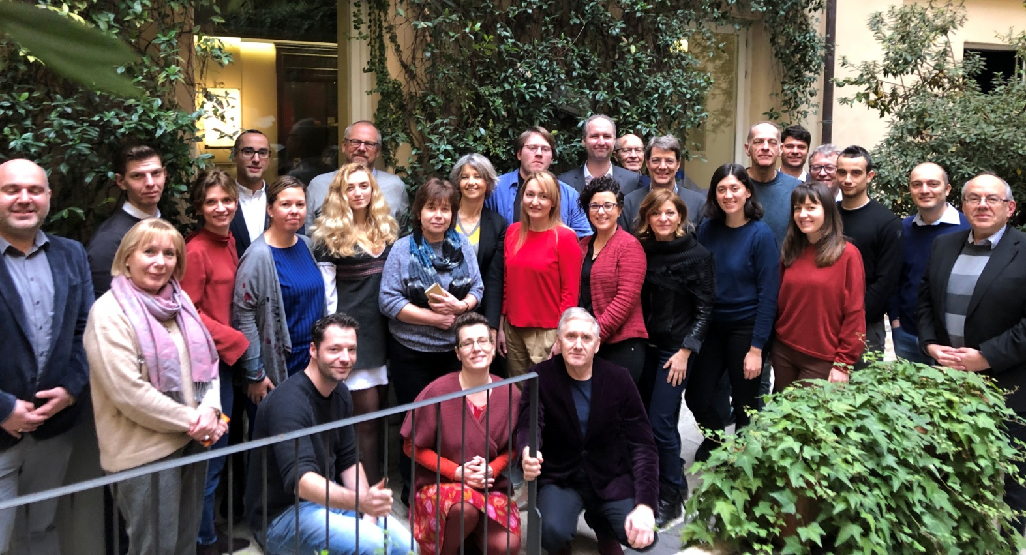
What is CARE?
CARE is a Research and Innovation Action jointly funded by the European Union (H2020 programme) and by the Ministry of Science and Higher Education of the Russian Federation

Slide 3
The CARE Project
EU funding period: 1st Jan 2019 – 30th Jun 2021
13 partners in Europe and Russia + 5 subcontractors in Russia
Project Coordinator: Francesca Incardona – EuResist Network
Project Scientific Coordinator: Jens Lundgren – RegionHovedstaden CHIP

Slide 4
CARE Project objectives
To fight HIV, TB and HCV by:
Discovery of biomarkers of TB and MDR-TB treatment success
Realization of a support environment for 2nd line MDR-TB treatment
Study of resistance to novel treatments for HIV and TB
Study of role of host genome in HIV disease progression
Best practice for HCV treatment
With a specific focus on eastern and northern Europe

Slide 5
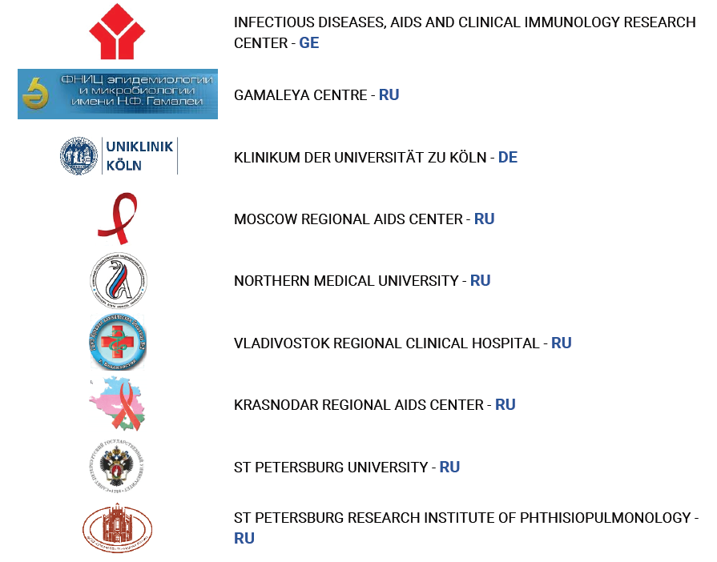
CARE Participants

Slide 6
The CARE ambition
Since 2019, relevant novel research findings have been generated within CARE with potential short-term application on the most relevant issues.
However, the ambition of the CARE Consortium is to pursue longer-term objectives such as upholding its collaborative research infrastructure to sustain and fuel the established scientific cooperation, allowing the expansion of activities beyond the current funding frame.

Slide 7
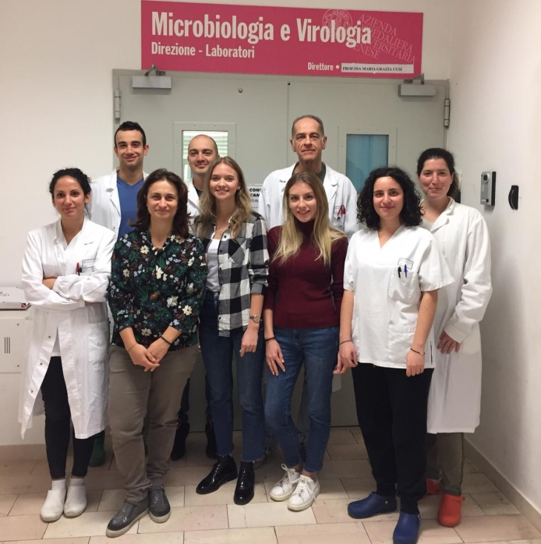
The CARE infrastructure
During 2019-2020 CARE put a tremendous and successful effort in building a powerful approval and technical infrastructure that permits the full functioning of the research projects actions between the European Union, Eastern Europe and the Russian Federation.
Data exchange – adoption of standards
Human samples exchange - also for genomic analysis
Personnel exchange – training activities

Slide 8
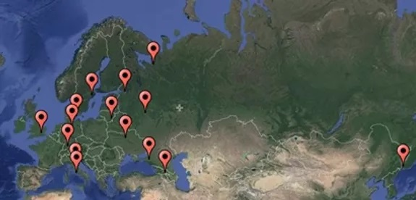
The CARE infrastructure

Slide 9
Participants enrolled in CARE
As of October 2020, CARE has enrolled over 10 000 people living with HIV, tuberculosis and/or hepatitis C into various substudies. Additionally, CARE has collected retrospective data on over 60 000 direct acting antivirals (DAA) treated people with HCV infection from Georgia, Sweden, Italy and pan-European HIV cohort study EuroSIDA.

Slide 10
TB Diagnostics (Imperial-UK, Arkhangelsk-RU, Vilnius-LT)
TB causes 10.4 million new cases globally. In order to comprehensively improve the clinical and epidemiological management of tuberculosis, particularly in Eastern European regions, CARE focuses on:
Development of non-invasive early TB diagnostics and definition of prognostic markers based on urine analysis
Definition of novel biomarkers of TB disease progression or cure, particularly in the context of multidrug resistant TB (MDR-TB)
Investigation of the role of SIGLEC 1 human gene in TB

Slide 11
TB Diagnostics - Ongoing results
We analysed plasma and urine specimens taken at regular intervals from the longitudinal cohort of susceptible and MDR-TB patients from Russia and Lithuania and realized the TB H2020 database.
Mass spectrometry methods were used for analysis. Using Linear Mixed Models for longitudinal data analysis, we identified metabolites whose abundance changes in response to TB treatment.
Some of the possible markers we identified, had been found in a previous diagnostic study (Isa, F. et al. EBioMedicine (2018)) and we evaluated them for their changes across time during TB treatment. The results of such longitudinal analysis in our TB H2020 dataset, indicate the potential value in defining cure of 2 biomarkers.

Slide 12
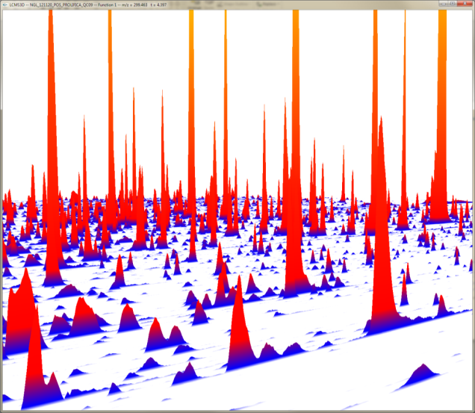
Mass spectrometry
LC-MS chromatogram and spectrum
From each urine sample we obtain a high resolution 3D datasets with
chromatographic (retention time), spectral (m/z), and intensity data!
Thousands of peaks are extracted with data processing algorithms.

Slide 13
TB Diagnostics - Ongoing results
In parallel, we established a new TB-Cohort with 353 patients and a small biobank of low and high-volume urine samples frozen at -80C. Patients with pulmonary TB, healthy controls, urinary TB infection, other respiratory infection have been enrolled. To identify specific lipids for rapid diagnosis of pulmonary TB from urine.
Also, we enrolled all the planned individuals in our Extrapulmonary TB patients cohort and started its analysis. This will allow us to test our hypothesis that the absence of Siglec-1 may delay the onset of immunity against TB, allowing for an early dissemination of bacteria to extrapulmonary regions.

Slide 14
Genotypic prediction and management of MDR-TB(FZB-DE, UniKoeln-DE, Tubingen-DE, IFP-MD, St.Petersburg-RU)
An effective approach to the management of MDR-TB is to tailor drug therapy regimens on the basis of comprehensive resistance testing. CARE contributes to this effort by:
Developing a genotype-to-phenotype prediction framework based on whole genome sequencing to infer second-line TB drug resistance from genotypic data and ease the choice of personalised treatment - developing a software tool for drug resistance prediction by genotype
Defining and testing a pilot model intervention of personalised effective MDR-TB treatment in Russia and other countries of the former Soviet Union, and designing associated clinical training modules

Slide 15
Genotypic prediction and management of MDR-TB Ongoing results
We developed the first version of the software tool to predict drug-resistances from whole genome sequencing (WGS). The tool is called “Geno2Pheno[TB]”, is based on Machine Learning (ML) and we identified Random Forests (RFs) as most suitable method so far. We trained and evaluated a variety of RF-models on different genetic features for 9 important drugs (Isoniazid, Rifampicine, Streptomycin, Ethambutol Pyrazinamide, Amikacin, Capreomycin, Flouroquinolones, Thioamides) using a set of up to 2,000 Mycobacterium tuberculosis genome sequences.
The resulting models showed overall significantly improved performance (e.g., sensitivity and specificity) compared to a state-of-the-art mutation catalogue, including both known resistance mediating and benign mutations.

Slide 16
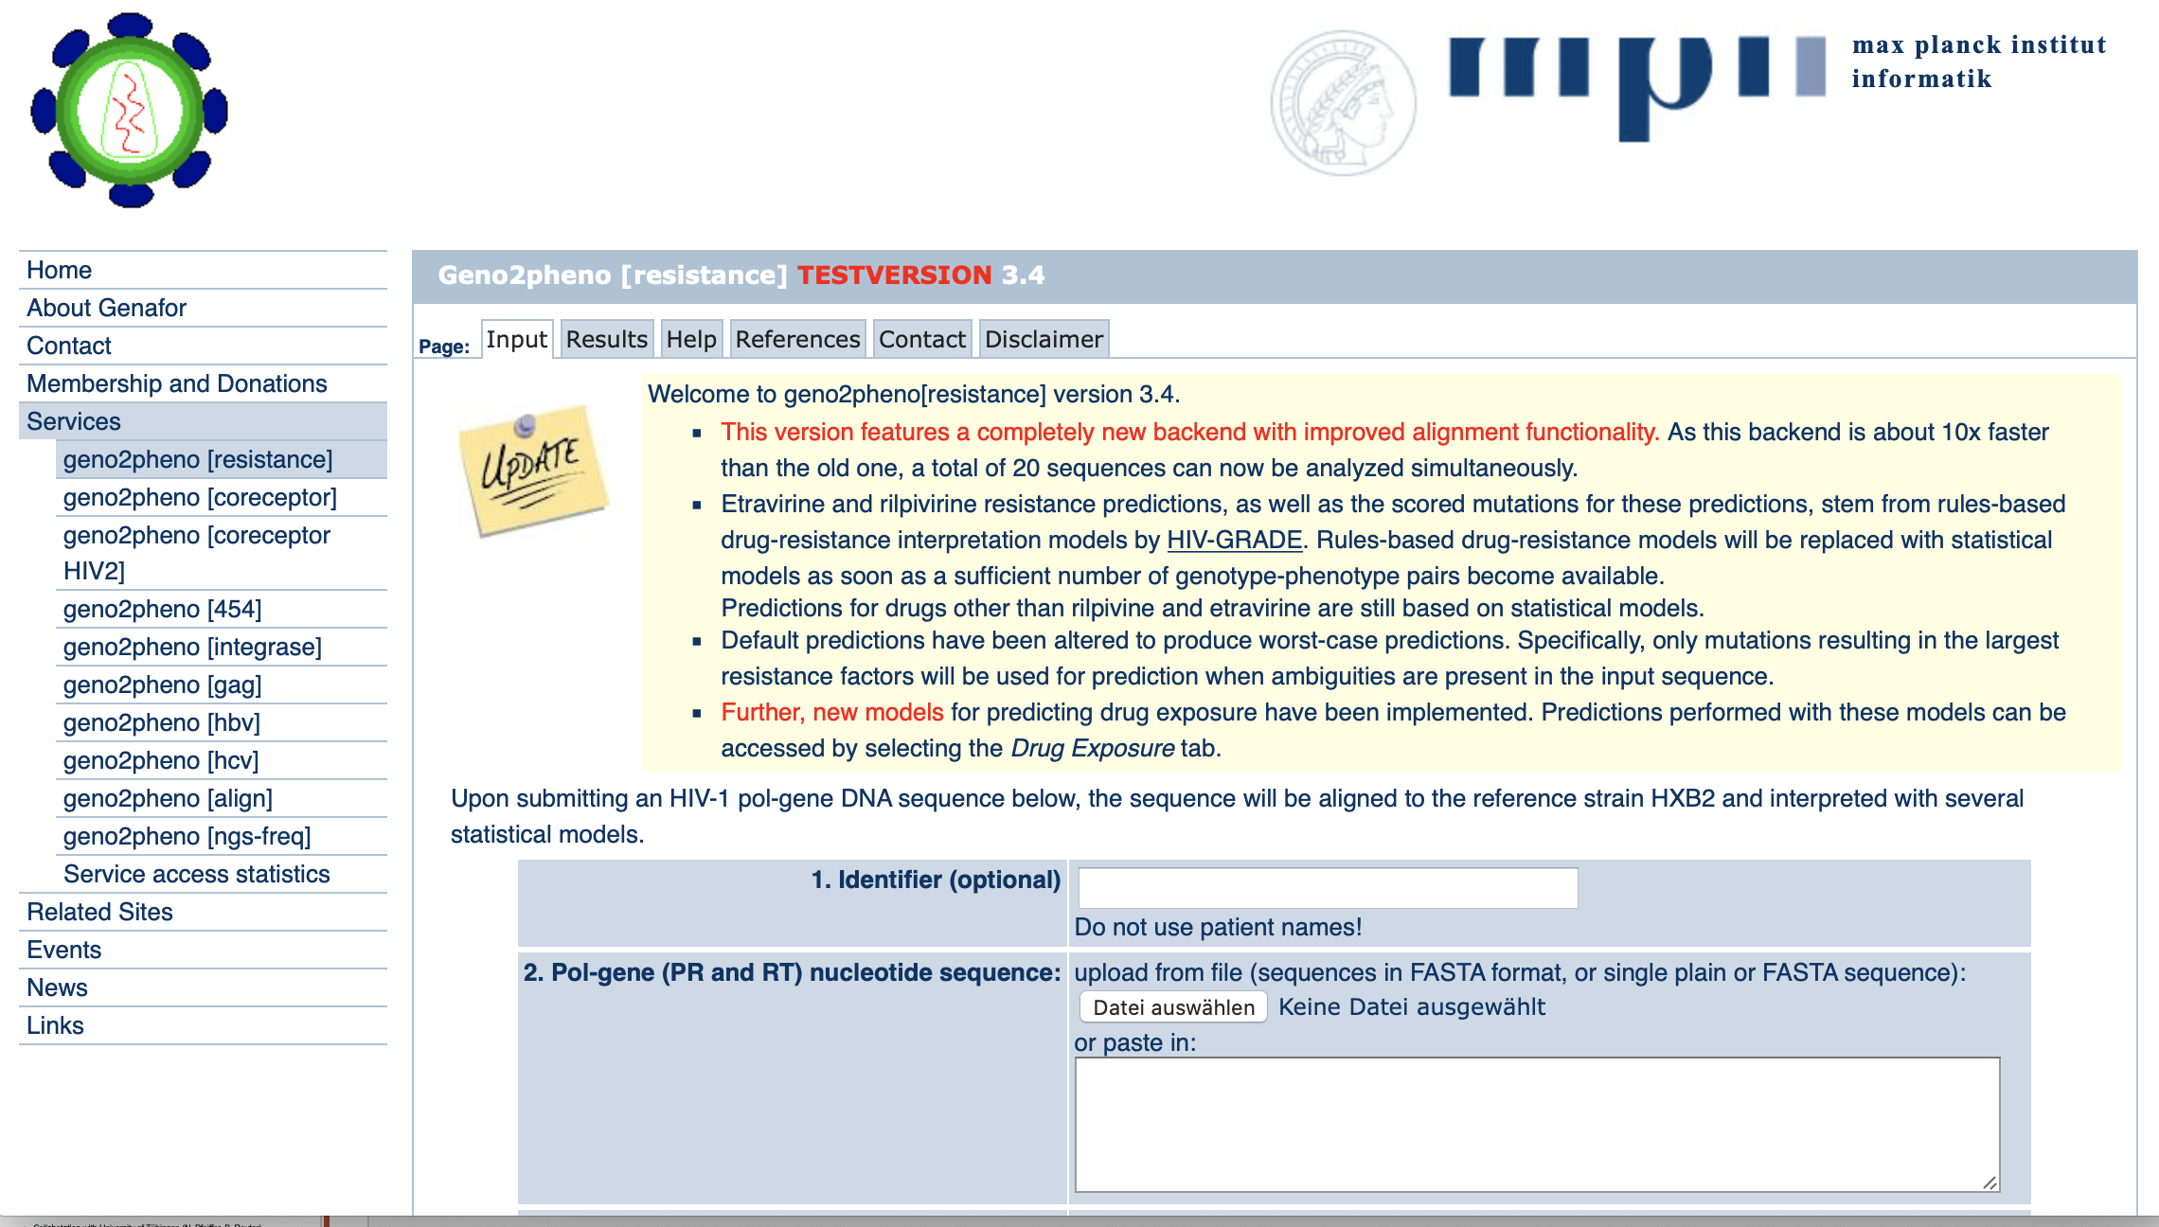
Geno-2-Pheno
Collabotation with University of Tübingen (N. Pfeiffer, B. Reuter)
Machine Learning algorithm based prediction of DR

Slide 17
Genotypic prediction and management of MDR-TB Ongoing results
In parallel, we were collecting over 400 clinical MDR-TB isolates for whole genome sequencing and extended phenotypic characterization from the Republic of Moldova and St. Petersburg, creating the MDR-TB cohort. With this newly generated dataset we will eventually describe the bacterial population structure and drug resistance development of MDR-TB isolates in Eastern Europe, and evaluate the geno2pheno[TB] tool.
A preliminary analysis of the newly established MDR-TB cohort permitted to identify genomic variants implicated in Bedaquiline (BDQ) resistance, a new hallmark drug for the treatment of MDR-TB.

Slide 18
HIV molecular epidemiology and new treatment strategies (Karolinska–SE, UniSiena-IT, UniKoeln-DE,Gamaleya-RU, PHC-UA, IDACIRC-GE, EuResist-IT)
Adopting a comprehensive approach to the management of HIV infection, CARE on one hand analyses the molecular epidemiology of the infection, including treatment efficacy and drug resistance in the highly prevalent HIV-1 sub-subtype A6; on the other hand, it prepares for the introduction of dolutegravir-based treatment, as recommended by the World Health Organisation.
In doing so, it also develops specific high throughput sequencing protocols/assay for monitoring HIV drug resistance adapted to HIV-1 A6 strains, and sets-up a drug resistance surveillance program in accordance with WHO guidelines.

Slide 19
HIV molecular epidemiology and new treatment strategies - Ongoing results 1
The Eastern European Database for molecular HIV-1 epidemiological analysis has been set-up aiming at enrolling 1100 patients in Russia, Georgia and Ukraine. So far, 1980 retrospective sequences and 859 prospective patients are included, with prospective samples and data collection ongoing.
Wild type in house integrase HIV+ sub-subtype A6 sequences have been obtained from Europe, Russia, and Georgia and a new consensus A6 sequence has been created.
When reanalysing the Swedish InfCareHIV database (>11.000), patients infected with A6 strains were identified for the first time with the first case from 1991 and a substantial increase in the numbers in the period 2007-2020.

Slide 21
HIV molecular epidemiology and new treatment strategies - Ongoing results 2
In the prospective HIV drug resistance substudy real-life samples from failing patients are collected from Russia and Ukraine. As of October 2020, 208 samples from patients failing INSTIs have been collected.
A high-through put sequencing assay for HIV-1 A6 strains has been established and validated on Swedish, German and Russian samples.
Samples from HIV-1 A6 patients have been shipped from Russia and Ukraine to Europe and the creation of recombinant A6 viruses has started.

Slide 22
HIV molecular epidemiology and new treatment strategies - Ongoing results 3
Sub-subtype A6 has been analyzed for its in vitro phenotypic susceptibility to integrase strand transfer inhibitors (INSTIs). The HIV-1 integrase coding region from twenty different A6 isolates showed to be as susceptible as the reference subtype B integrase to INSTIs, including dolutegravir, bictegravir, cabotegravir. Further analysis is ongoing to evaluate the genetic barrier of A6 isolates to INSTIs through in vitro drug resistance selection experiments.

Slide 23
HIV/HCV treatment and Host genomics (CHIP-DE, PHC-UA, IDACIRC-GE, Gamaleya-RU, UniSiena-IT, Karolinska-SE)
The CARE Consortium aims to identify genetic variants associated with markers of HIV-pathogenesis (e.g. HIV-viral load), serious-AIDS and non-AIDS (e.g. cardiovascular disease and cancer) as well as toxicities of commonly used ART drugs. The results will be compared to the genotypic information from an existing Danish HIV- cohort of 2032 participants and a global HIV cohort of 8500 participants from the INSIGHT clinical trials network.
In the area of Viral hepatitis research, the CARE Consortium seeks to derive best practice recommendations for the direct acting antivirals (DAA) hepatitis C treatment.

Slide 24
HIV/HCV treatment and Host genomics – Ongoing results
We have successfully established a new prospective HIV Eastern European cohort for human genomic studies in Georgia, Ukraine and Russia with enrolment target of 4,500 participants. As of 14th October 2020, a total of 4035 unselected HIV positive persons have been enrolled in three countries (64.5% male, median age of 40 years, 21.1% with prior AIDS, 94.3% on ART) to analyse host genome.
The study participants have donated blood at the time of enrolment for host genomic analysis and the CARE Host genomic biobank of whole blood samples has been established. Samples from 2463 participants from Ukraine and Georgia have been shipped to Copenhagen, of which, 1500 participants have been selected for the first phase of host genome analysis. Additionally, 350 retrospective patients with a longer follow-up period and DNA samples available will be enrolled in Russia.
.

Slide 25
HIV/HCV treatment and Host genomics – Ongoing results
A new multicenter HCV datalake for retrospective studies has been created by merging data from existing cohorts. The datalake merged data on around 60 000 DAA treated HCV patients in Georgia, Sweden, Italy and the EuroSIDA study.
Furthermore, we have enrolled an extensive prospective cohort of over 6500 people with HIV and HIV/HCV co-infection in Georgia, Russia and Ukraine. Detailed clinical and demographical data have been collected from the region of the world where we have little data so far.

Slide 31
CARE ambition and plans for the future
CARE collaborations and structures constitute a value that should not be lost: the terrific work done so far is the basis for innovative and translational research that will bring the results to the clinics.
CARE partners are motivated to continue and expand their collaboration in areas (geographical and scientific) that are considered of pivotal relevance for the healthcare of the European Region.
CARE realised a Strategic Plan with the priorities for health research cooperation in the period 2021-2026, individuated by the scientists involved in the project.

Slide 32
CARE strategic plan TB
To carry on research activities related to TB especially to further validate previous promising research findings and bring them to the clinic and/or to the market. This includes:
larger scale diagnostic TB and proof-of-cure biomarker evaluation studies / prospective trials to confirm their utility and impact on treatment outcome.
Finalisation of personalized MDR-TB clinical management support tools based on MDR strains genotyping and prospective trial to evaluate their impact.

Slide 33
CARE strategic plan HIV
To carry on research activities related to HIV, providing the possibility to study crucial issues that require long times of observation in order to collect the needed number of clinical events. In particular it refers to the study of:
Response to dolutegravir and possibly other upcoming INSTIs and other antiretroviral drugs in an area dominated by diverse and peculiar HIV clades. Notably dolutegravir roll out is just beginning in this area, thus the need to prolong this surveillance is imperative;
Pretreatment and emergent drug resistance along with upcoming changes in the paradigm of first-line and rescue antiretroviral treatment and the increase of the ART coverage in Eastern Europe;

Slide 34
CARE strategic plan HIV
Single nucleotide polymorphisms and their correlation with long-term adverse effects of ART, with a focus on the tolerability of integrase inhibitors that have been introduced in this region only recently;
The impact of host genetics on the risk of development of AIDS and serious non-AIDS clinical events such as malignancies and cardiovascular disease, as well as on ART side effects.

Slide 35
CARE strategic plan: funding
CARE has put in place a multi-sponsor funding strategy to seek for unrestricted grants from pharmaceutical companies for the period 2021-2022; MSD, ViiV and GILEAD are engaged.
Horizon Europe will be considered.
We ask for your support too.

Slide 36
On behalf of all the CARE consortium
Thank you for your attention!
f.incardona@euresist.org

